Slide 1
DAFNet: Dual Attention with Feature Aggregation Network for Real-Time Semantic Segmentation
學生 劉育瑋
指導教授 張隆紋
Notes:
各位老師好 我是劉育瑋 我的論文題目是DAFNET:Dual Attention with Feature Aggregation Network for Real-Time Semantic Segmentation

Slide 2
Outline
Introduction
Related works
Methods
Datasets prepared
Experiments and Results
Notes:
我的報告分成五個部分
第一個部分 Introduction:首先我會介紹什麼是語意分割以及在語意分割中我們想改善的問題
第二個部分 related work:在related work中，我會介紹我們引用了哪些方法
第三個部分 method:就是我們所提出的方法
第四個部分 dataset prepared:在進入實驗之前，我們會先介紹用來評估的資料集
最後第五個部分就是我們的實驗結果

Slide 3
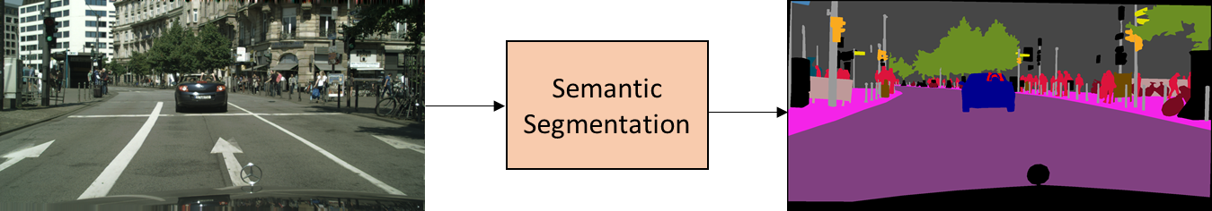
Introduction
Related works
Datasets prepared
Methods
Experiments
Results
In the semantic segmentation task, we give each pixel a corresponding predicted label.
road | sidewalk | building | wall | fence | pole | traffic light | traffic sign | vegetation | terrain
sky | person | rider | car | truck | bus | train | motorcycle | bicycle | others
Notes:
在語意分割任務中，我們會給予輸入圖中每個像素一個對應的預測，如這張圖所示，我們將輸入圖代入語意分割演算法中，得到了一張預測圖，這張預測圖一共包含了20種顏色，即代表共有20種不同的類別

Slide 4
Introduction
Related works
Datasets prepared
Methods
Experiments
Results
In semantic segmentation tasks, we often use mIoU (Mean Intersection over Union) as an evaluation indicator.
As shown in the figure, the IoU of category B is 20/49.
A
30 | 5 | 1 | 4
5 | 20 | 8 | 2
9 | 7 | 65 | 10
0 | 2 | 8 | 22
B
Ground Truth
C
D
A
B
C
D
Predicted Value
Notes:
在語意分割中我們常用Miou作為衡量精準度的一個指標，舉例來說，我們的語意分割中一共有ABCD四個標記類別，其算法就是將交集個數除聯集個數，以B來說它的iou就是
將紫色區塊除上紅色區塊(即我們將輸入預測為B的像數數量)加上藍色區塊(即真實為B的像數數量)。最後再將4種類別的IOU取平均就可得到MIOU

Slide 5
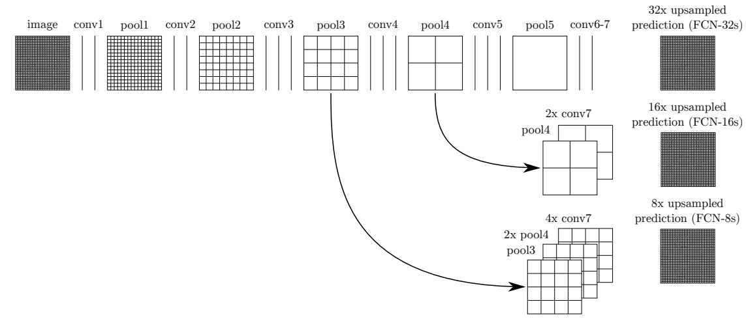
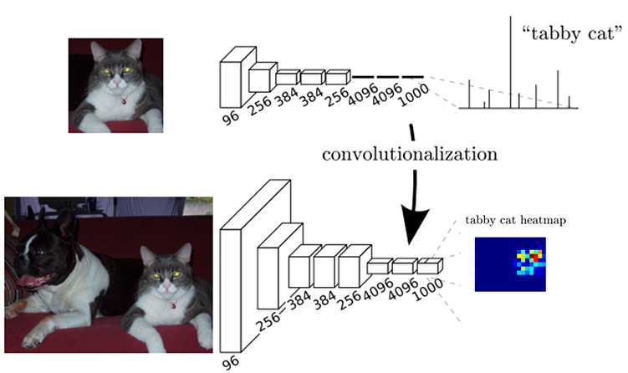
Introduction
Related works
Datasets prepared
Methods
Experiments
Results
With the development of deep learning, research on semantic segmentation has also begun.
J. Long, E. Shelhamer, and T. Darrell, “Fully convolutional networks for semantic segmentation,” in Proceedings of the IEEE Conference on Computer Vision and Pattern Recognition, 2015.
Notes:
隨著深度學習的發展，開始有了一些作品使用深度學習來處理語意分割的問題。在2015所提出的FCN，將分類網路中最後的全連接層替換為捲積層，因此網路只會進行一連串的捲積與池化，這樣的設計使得我們可得到每個像素的類別預測，如左下圖所示，我們所得到的結果從一組分類概率變為一張分類圖片。也在FCN的成功之後，越來越多方法基於這樣的設計去優化它。

Slide 6
Introduction
Related works
Datasets prepared
Methods
Experiments
Results
1.Even if FCN achieves great success, we still expect to continue to advance its accuracy.
2.With the demand of mobile devices, real-time semantic segmentation network becomes an issue.
3. As the model is simplified to reduce the consumption of computing resources, the accuracy of real-time semantic segmentation is reduced.
4. We want to optimize the accuracy of the real-time semantic segmentation network with a small increase in computing resource consumption.
Notes:
但即便FCN得到不錯的效果，我們仍希望繼續推進它的精準度，同時，也隨著我們對於移動裝置以及其他即時應用的需求，即時語意分割網路也成為了一個議題。在設計即時語意分割網路時，時常透過簡化架構來提升速度，但這樣就會漸少精準度，因此我們提出的方法希望在很少的計算量增加下提高即時語意分割網路的精準度。

Slide 7
Introduction
Related works
Datasets prepared
Methods
Experiments
Results
1. Attention Module
SE-Block [1]
Non-local block [2]
2. Convolutional Neural Network
ResNet [4]
Xception [5]
MobileNet [6]
3. Real-time Semantic Segmentation
BiSeNet [3]
4. Spatial Pyramid Pooling
SPPNet [7]
Notes:
我們所參考的方法包括1.attention module 2.CNN 3.Real-time semantic segmentation 4. spatial pyramid pooling

Slide 8
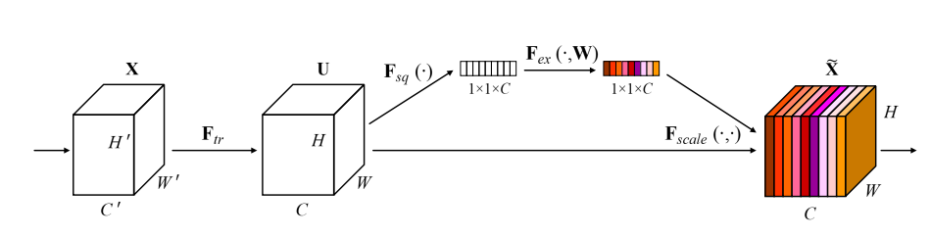
Introduction
Related works
Datasets prepared
Methods
Experiments
Results
SENet
average pooling
linear layer
[1] J. Hu, L. Shen, and G. Sun, “Squeeze-and-excitation networks,” in Proceedings of the IEEE Conference on Computer Vision and Pattern Recognition, 2018.
Notes:
近期許多語意分割的作品會加入注意力模組，它可以幫助我們探索特徵與特徵之間的關係
我們還可以根據探討的維度不同，將Attention module大致分成channel-wise以及point-wise兩種
SENet所提出的SEBlock，會將輸入特徵做channel-wise的加權，如這個架構圖所示，我們的特徵會先經過一個平均池化層將特徵採樣至1X1XＣ，再經由linear層的運算後得到C個數，這C個數分別對應到C個channel
來做channel-wise的乘法

Slide 9
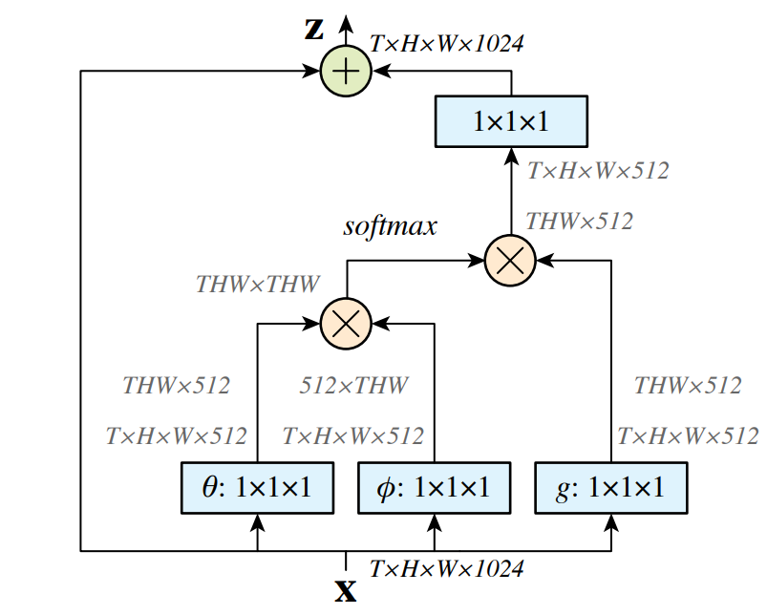
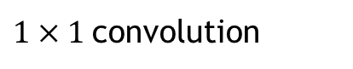
Introduction
Related works
Datasets prepared
Methods
Experiments
Results
Non-local Block
X
matrix multiplication
+
matrix addition
$1×1$convolution
T,H,W
batch,height,width
[2] X. Wang, R. Girshick, A. Gupta, and K. He, “Non-local neural networks,” in Proceedings of the IEEE Conference on Computer Vision and Pattern Recognition, 2018
Notes:
再來則是point-wise的attention module
在2018年所提出的non-local block，他會先將輸入特徵做降維，再將降維後的特徵兩兩做矩陣相乘，最後再提升維度到原先大小。也因為矩陣相乘的緣故，當特徵較大計算量就會變得很大。

Slide 10
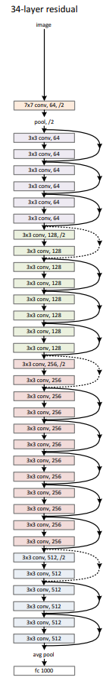
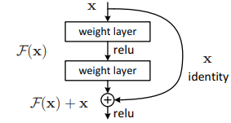
Introduction
Related works
Datasets prepared
Methods
Experiments
Results
ResNet
[4] K. He, X. Zhang, S. Ren, and J. Sun, “Deep residual learning for image recognition,” in Proceedings of the IEEE
Conference on Computer Vision and Pattern Recognition, 2016
Notes:
在CNN的部分，我們使用了兩種輕量CNN作為我們網路的backbone 分別是Resnet18以及Xception39。
2016年所提出的resnet，因為發現網路過深會導致學習效果變差，提出了residual learning的方法，如下方圖所示，我們把運算前的特徵加到運算後特徵，避免特徵在網路訓練時效果變得更差

Slide 11
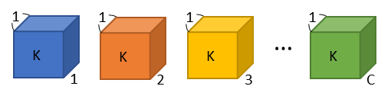
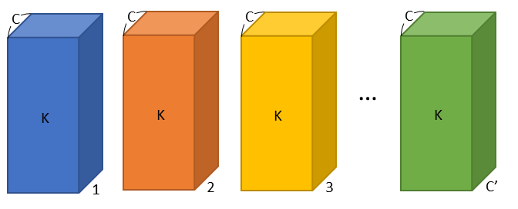
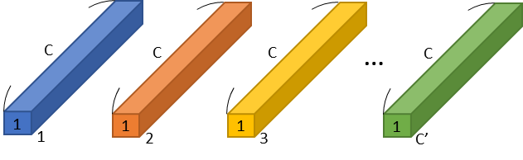
Introduction
Related works
Datasets prepared
Methods
Experiments
Results
Depthwise Separable Convolution
kernel size: k
input channel: 1
output channel: C
kernel size: k
input channel: C
output channel: C’
depth-wise convolution
kernel size: 1
input channel: C
output channel: C’
Standard Convolution
[6] A. G. Howard et al., “MobileNets: Efficient convolutional neural networks for mobile vision applications,” arXiv preprint arXiv:1704.04861v1 [cs.CV], 2017
point-wise convolution
Depthwise Separable Convolution
Notes:
至於Xception39則是使用類似depth-wise separable的方法，將普通捲積拆成depth-wise convolution以及point-wise convolution在效能跟速度做出取捨
如上圖所示我們將一般的kxkxcxc’的捲積拆解成kxkx1xc以及1x1xcxc’，可以將運算量減少至原先的$\frac{1}{C′}+\frac{1}{k^{2}}$

Slide 12
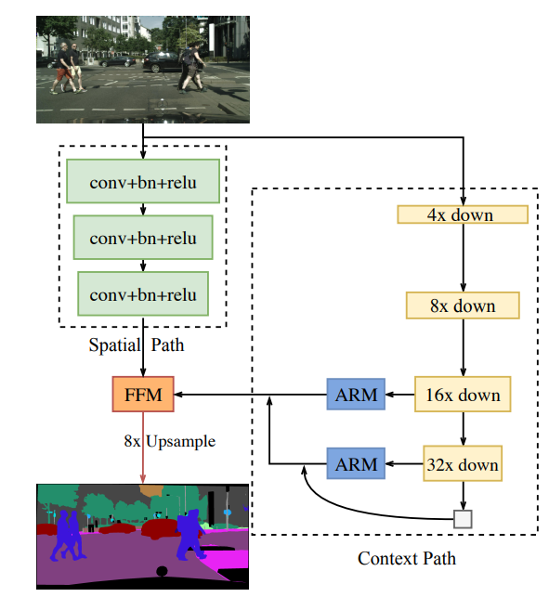
Introduction
Related works
Datasets prepared
Methods
Experiments
Results
Real-time Semantic Segmentation
[3] C. Yu, J. Wang, C. Peng, C. Gao, G. Yu, and N. Sang. Bisenet: “Bilateral segmentation network for real-time semantic segmentation.” in Proceedings of the European Conference on Computer Vision, 2018.
Notes:
我們的方法基於Bisenet進行設計，在介紹我們的方法之前，我們先簡單介紹Bisenet。Bisenet一共分成兩條路徑，左邊較淺的網路是空間路徑用來取得空間信息，空間信息就是圖片中較細節的資訊，
而右邊較深的網路則是語意路徑，用來取得語意訊息，語意訊息用來幫助我們得到像素中更精確的分類。在語意路徑中，我們會透過CNN backbone對圖片進行下採樣再將其經由ARM這樣的注意力模塊
進行精煉，並依序對高等級與低等級的特徵兩兩聚合，最後得到語意路徑的特徵後再與空間路徑的特徵進行聚合，得到我們的最後結果。

Slide 13
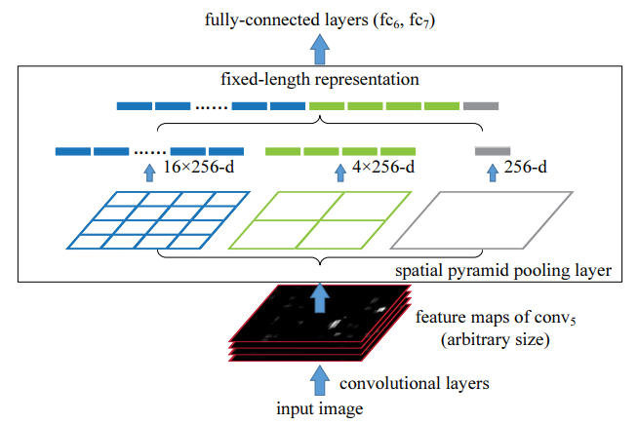
Introduction
Related works
Datasets prepared
Methods
Experiments
Results
Spatial Pyramid Pooling
[7] K. He, X. Zhang, S. Ren, and J. Sun, “Spatial pyramid pooling in deep convolutional networks for visual recognition,” in Proc. Eur. Conf. Comput. Vis., 2014, pp. 346–361
Notes:
此外為了得到不同尺寸下訊息並縮小特徵大小，我們也採用了spatial pyramid pooling，
如上圖所示，我們會將輸入特徵依照不同Scale的最大池化進行下採樣最後再連接在一起，即便特徵大小不同，最後都會被採樣成16+4+1的大小

Slide 14
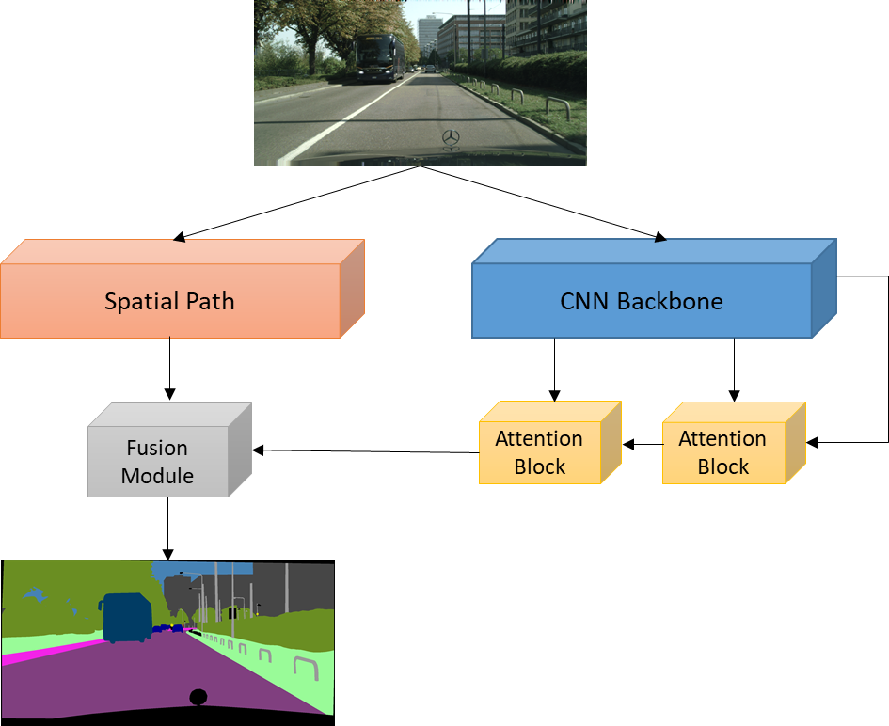
Introduction
Related works
Datasets prepared
Methods
Experiments
Results
Spatial Path
Context Path
Our main optimization part
Simplified DAFNet architecture diagram

Slide 15
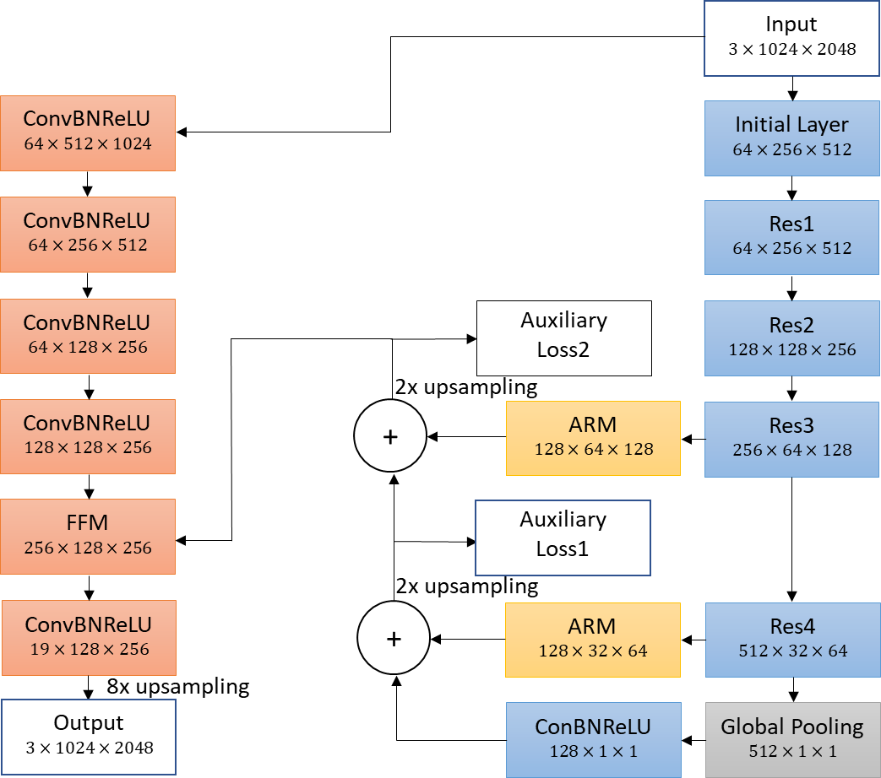
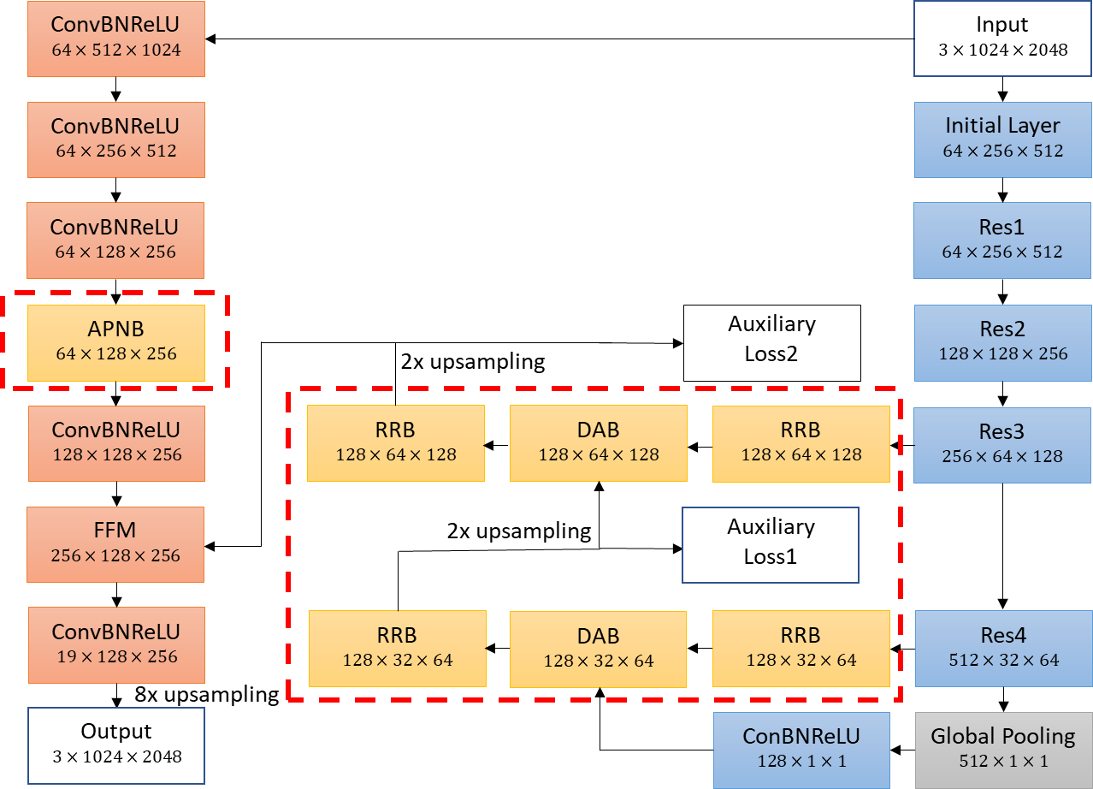
Introduction
Related works
Datasets prepared
Methods
Experiments
Results
We propose our method based on BiSeNet.
BiSeNet [3]
DAFNet (Ours)

Slide 16
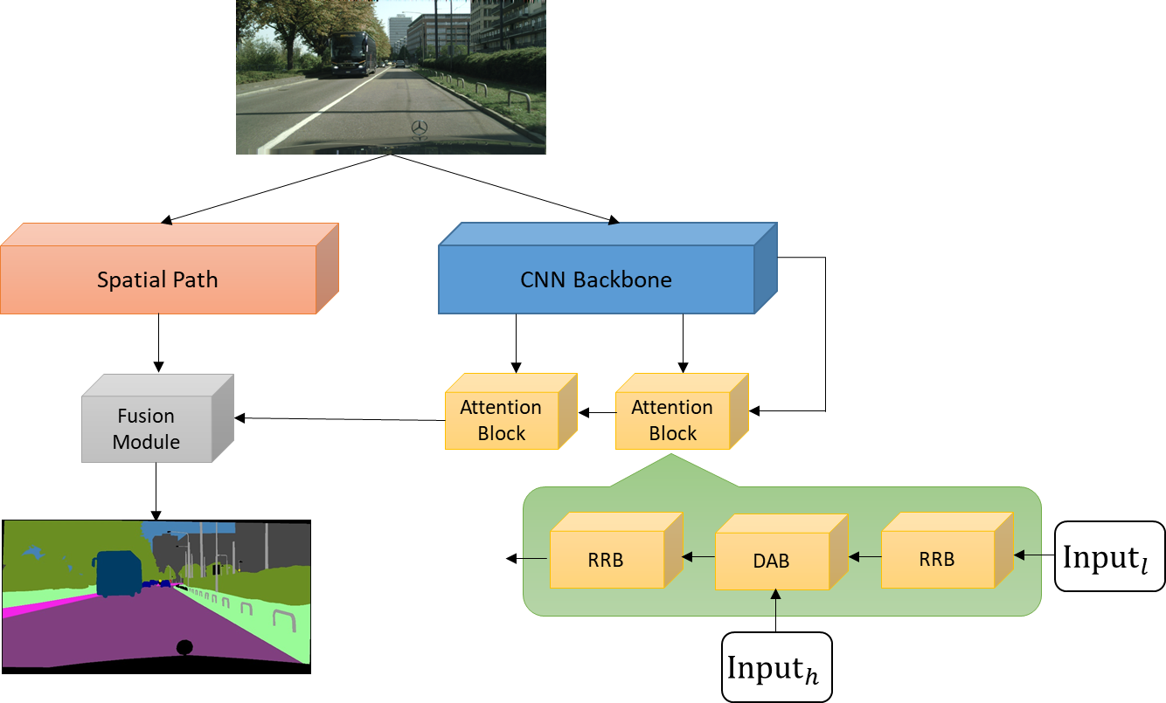
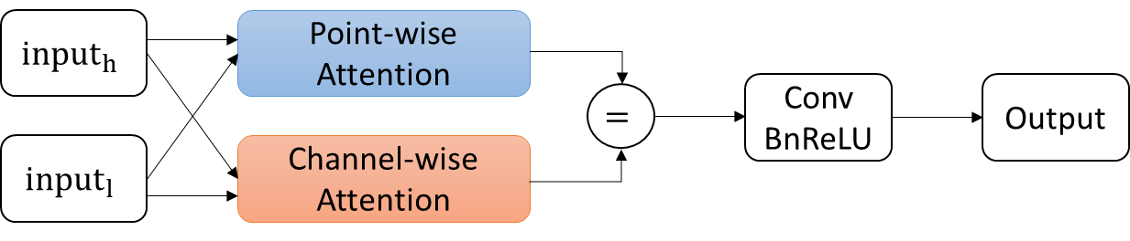
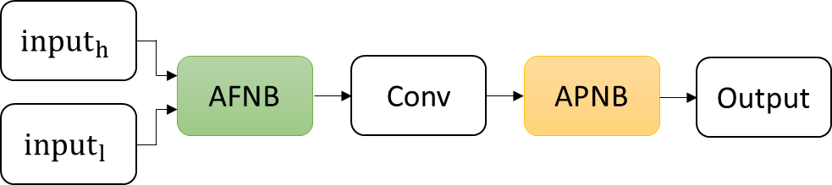
Introduction
Related works
Datasets prepared
Methods
Experiments
Results
Dual Attention Block
=
concatenate
Dual Attention Block (DAB)
Point-wise Attention Module in DAB

Slide 17
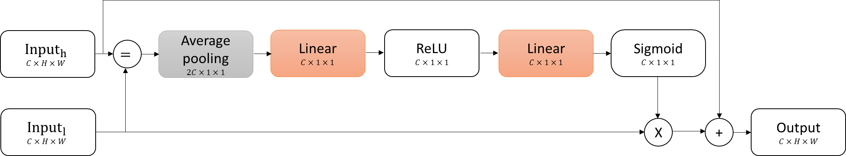
The details of Channel-wise Attention Block in DAB
=
concatenate
Dual Attention Block (DAB)
X
channel-wise multiplication
+
pixel-wise addition
Channel-wise Attention Module in DAB

Slide 18
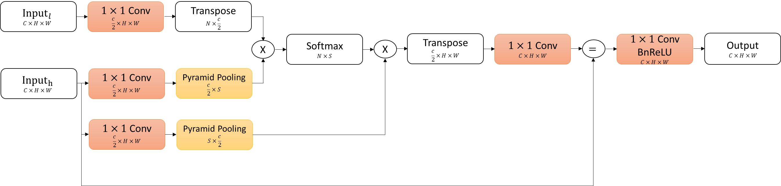
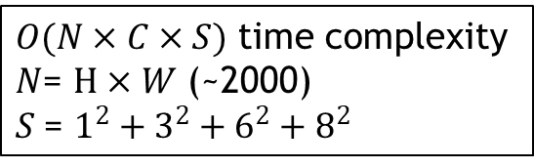
The details of Point-wise Attention Module in DAB
$O(N×C×S)$ time complexity
$N$= $H×W$ (~2000)
$S$= $1^{2}+3^{2}+6^{2}+8^{2}$
=
concatenate
Point-wise Attention Module in DAB
X
matrix multiplication
Asymmetric Fusion Non-local Block

Slide 19
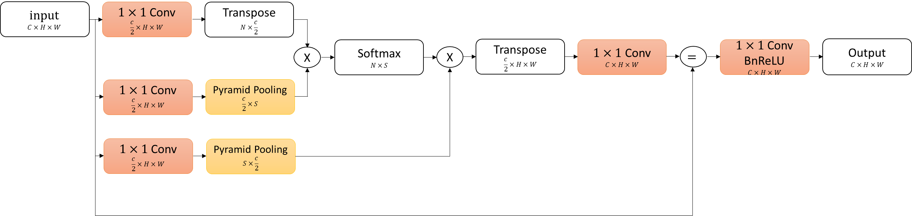
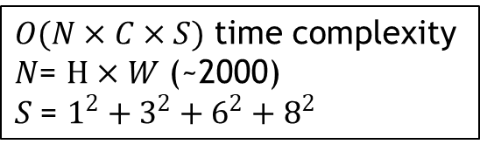
The details of Point-wise Attention Block in DAB
$O(N×C×S)$ time complexity
$N$= $H×W$ (~2000)
$S$= $1^{2}+3^{2}+6^{2}+8^{2}$
=
concatenate
Point-wise Attention Block in DAB
X
matrix multiplication
Asymmetric Pyramid Non-local Block

Slide 20
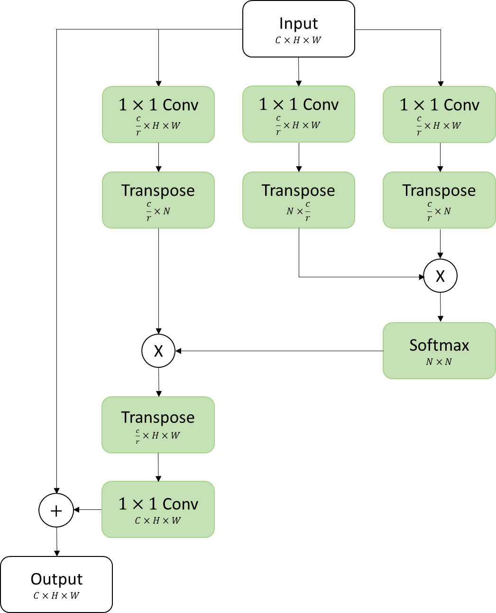
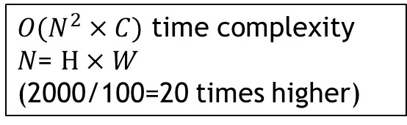
Comparison of Non-local Block and Asymmetric Non-local Block
$O(N^{2}×C)$ time complexity
$N$= $H×W$
(2000/100=20 times higher)
X
channel-wise multiplication
+
pixel-wise addition
Non-local Block

Slide 21
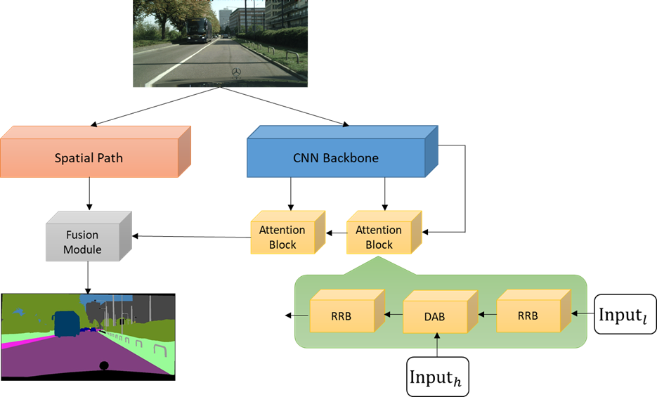
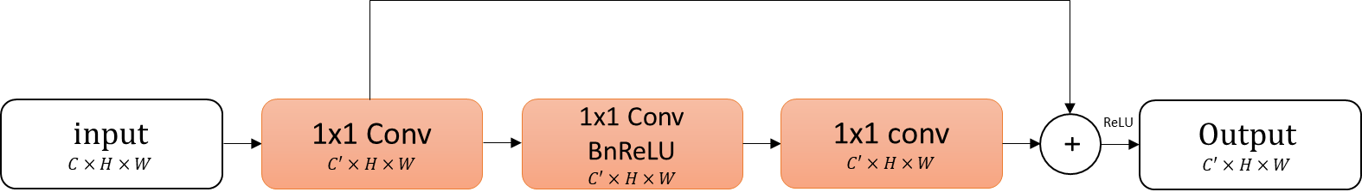
Introduction
Related works
Datasets prepared
Methods
Experiments
Results
Refine Residual Block
+
pixel-wise addition

Slide 22
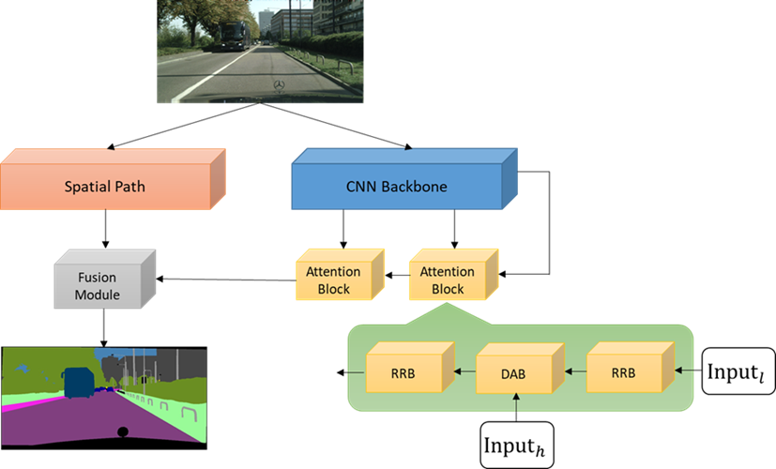
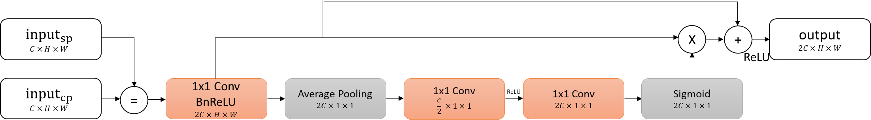
Introduction
Related works
Datasets prepared
Methods
Experiments
Results
Feature Fusion Module
=
concatenate
X
channel-wise multiplication
+
pixel-wise addition

Slide 23
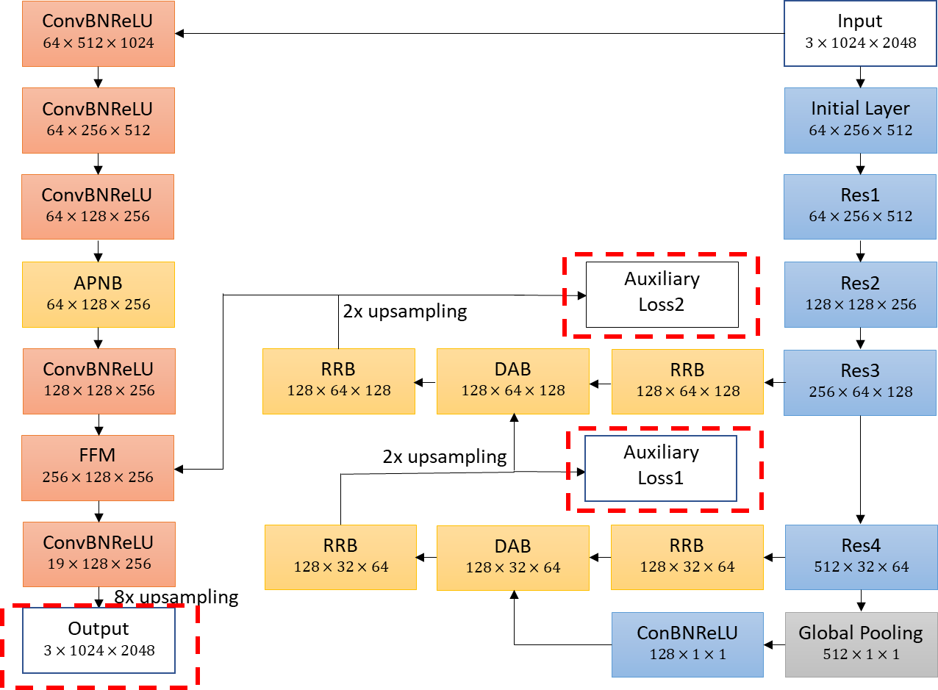
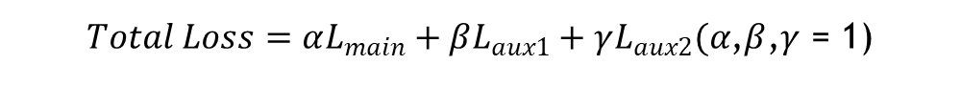
Introduction
Related works
Datasets prepared
Methods
Experiments
Results
Loss Function
$Total Loss=αL_{main}+βL_{aux1}+γL_{aux2}(α$,$β$,$γ$ = 1)

Slide 24

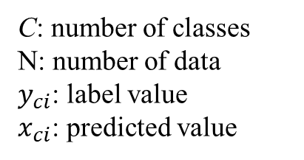

Introduction
Related works
Datasets prepared
Methods
Experiments
Results
Loss Function
$$Total Loss=αL_{main}+βL_{aux1}+γL_{aux2}$$
C: number of classes
N: number of data
$y_{ci}$: label value
$x_{ci}$: predicted value
$$Cross Entropy= \sum_{c=1}^{C}{\sum_{i=1}^{N}{−y_{ci}\log{x_{ci}}{}}}$$
$$Dice Loss=2\frac{|A∩B|}{\left|A\right|+|B|}$$
A: ground truth
B: predicted value

Slide 25
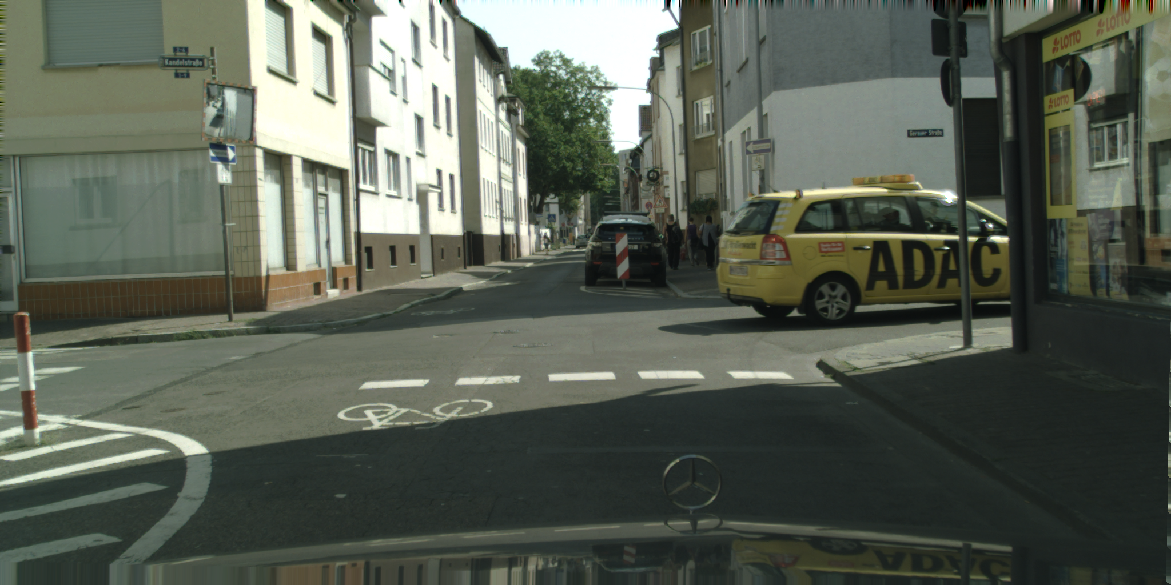
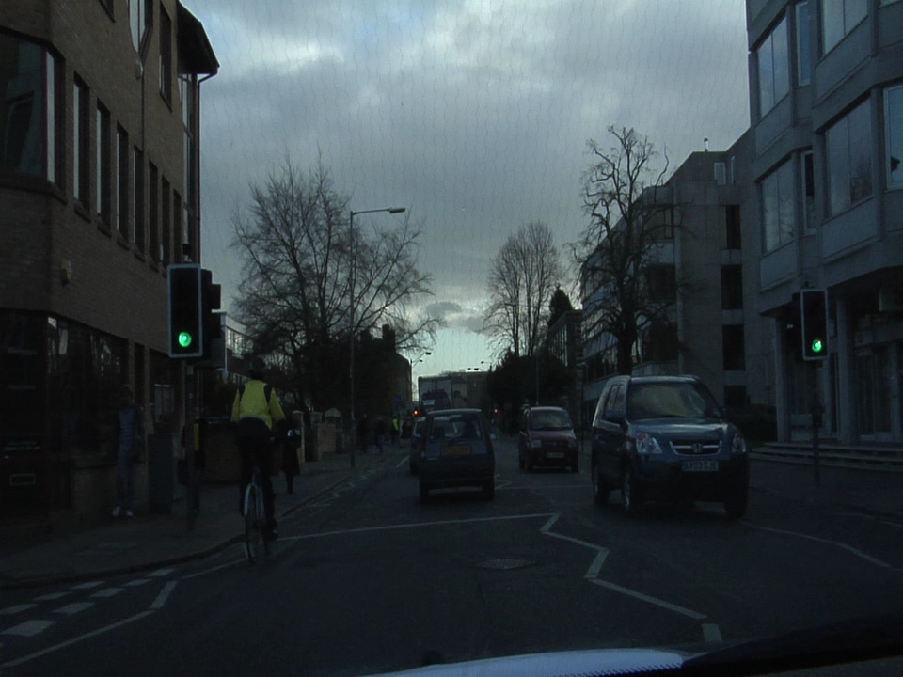
Introduction
Related works
Datasets prepared
Methods
Experiments
Results
Cityscape Dataset
2975 images for training
500 images for validation
1525 images for testing
19 classes (19+1 others)
Resolution of 2048 x 1024
Camvid Dataset
367 images for training
101 images for validation
233 images for testing
11 classes (11+1 others)
Resolution of 960 x 720

Slide 26
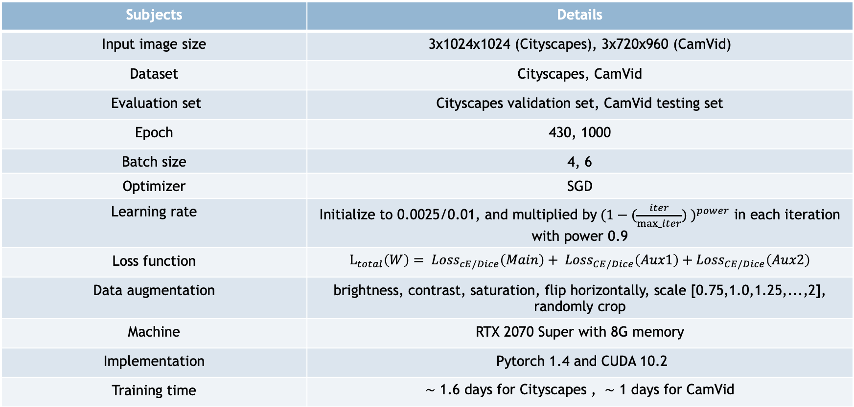
Introduction
Related works
Datasets prepared
Methods
Experiments
Results
Training Details
Subjects | Details
Input image size | 3x1024x1024 (Cityscapes), 3x720x960 (CamVid)
Dataset | Cityscapes, CamVid
Evaluation set | Cityscapes validation set, CamVid testing set
Epoch | 430, 1000
Batch size | 4, 6
Optimizer | SGD
Learning rate | Initialize to 0.0025/0.01, and multiplied by${(1−(\frac{iter}{max_iter}) )}^{power}$ in each iteration with power 0.9
Loss function | $L_{total}\left(W\right)= {Loss}_{cE/Dice}\left(Main\right)+ {Loss}_{CE/Dice}\left(Aux1\right)+{Loss}_{CE/Dice}\left(Aux2\right)$
Data augmentation | brightness, contrast, saturation, flip horizontally, scale [0.75,1.0,1.25,...,2], randomly crop
Machine | RTX 2070 Super with 8G memory
Implementation | Pytorch 1.4 and CUDA 10.2
Training time | ∼ 1.6 days for Cityscapes , ∼ 1 days for CamVid

Slide 27
Introduction
Related works
Datasets prepared
Methods
Experiments
Results
Ablation Study for the Adjusted Blocks
Ablation study for the adjusted blocks on Cityscapes validation set

Slide 28
Introduction
Related works
Datasets prepared
Methods
Experiments
Results
Ablation Study for DAB
Ablation study for DAB on Cityscapes validation set

Slide 29
Introduction
Related works
Datasets prepared
Methods
Experiments
Results
Comparison of Inputs
Comparison of single input DAB and dual input DAB

Slide 30
Introduction
Related works
Datasets prepared
Methods
Experiments
Results
Speed and Accuracy Evaluation
Speed and accuracy evaluation on Cityscapes validation set

Slide 31
Introduction
Related works
Datasets prepared
Methods
Experiments
Results
Multi-scale evaluation
Multi-scale accuracy evaluation on Cityscapes validation set

Slide 32
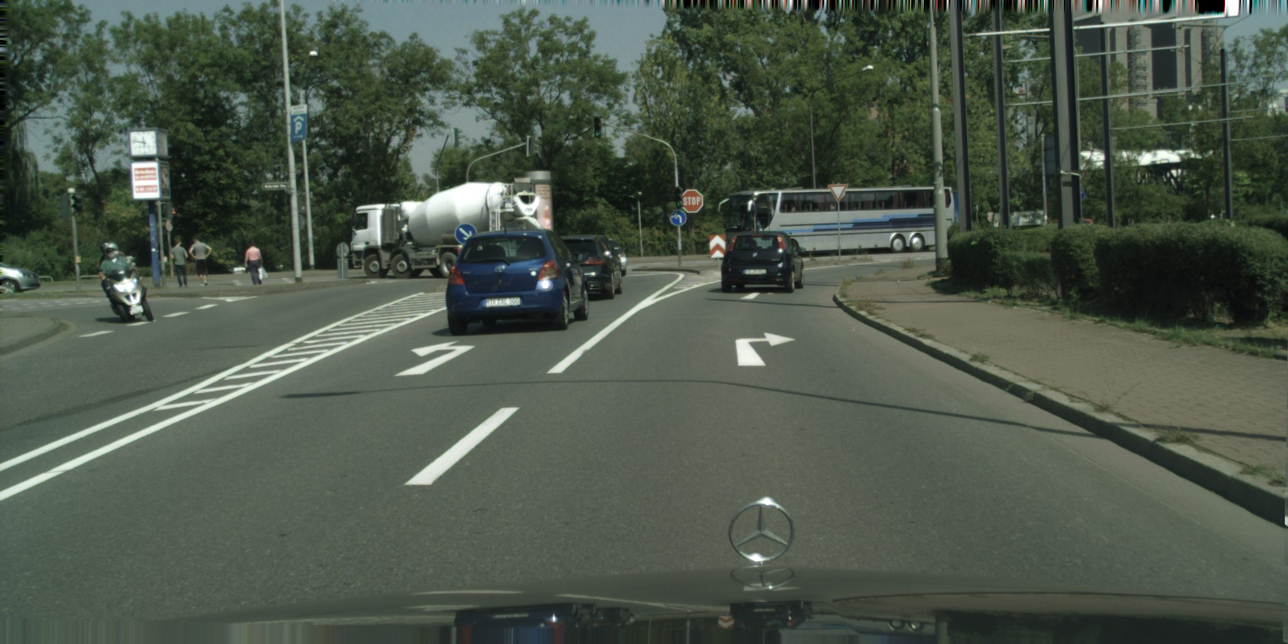
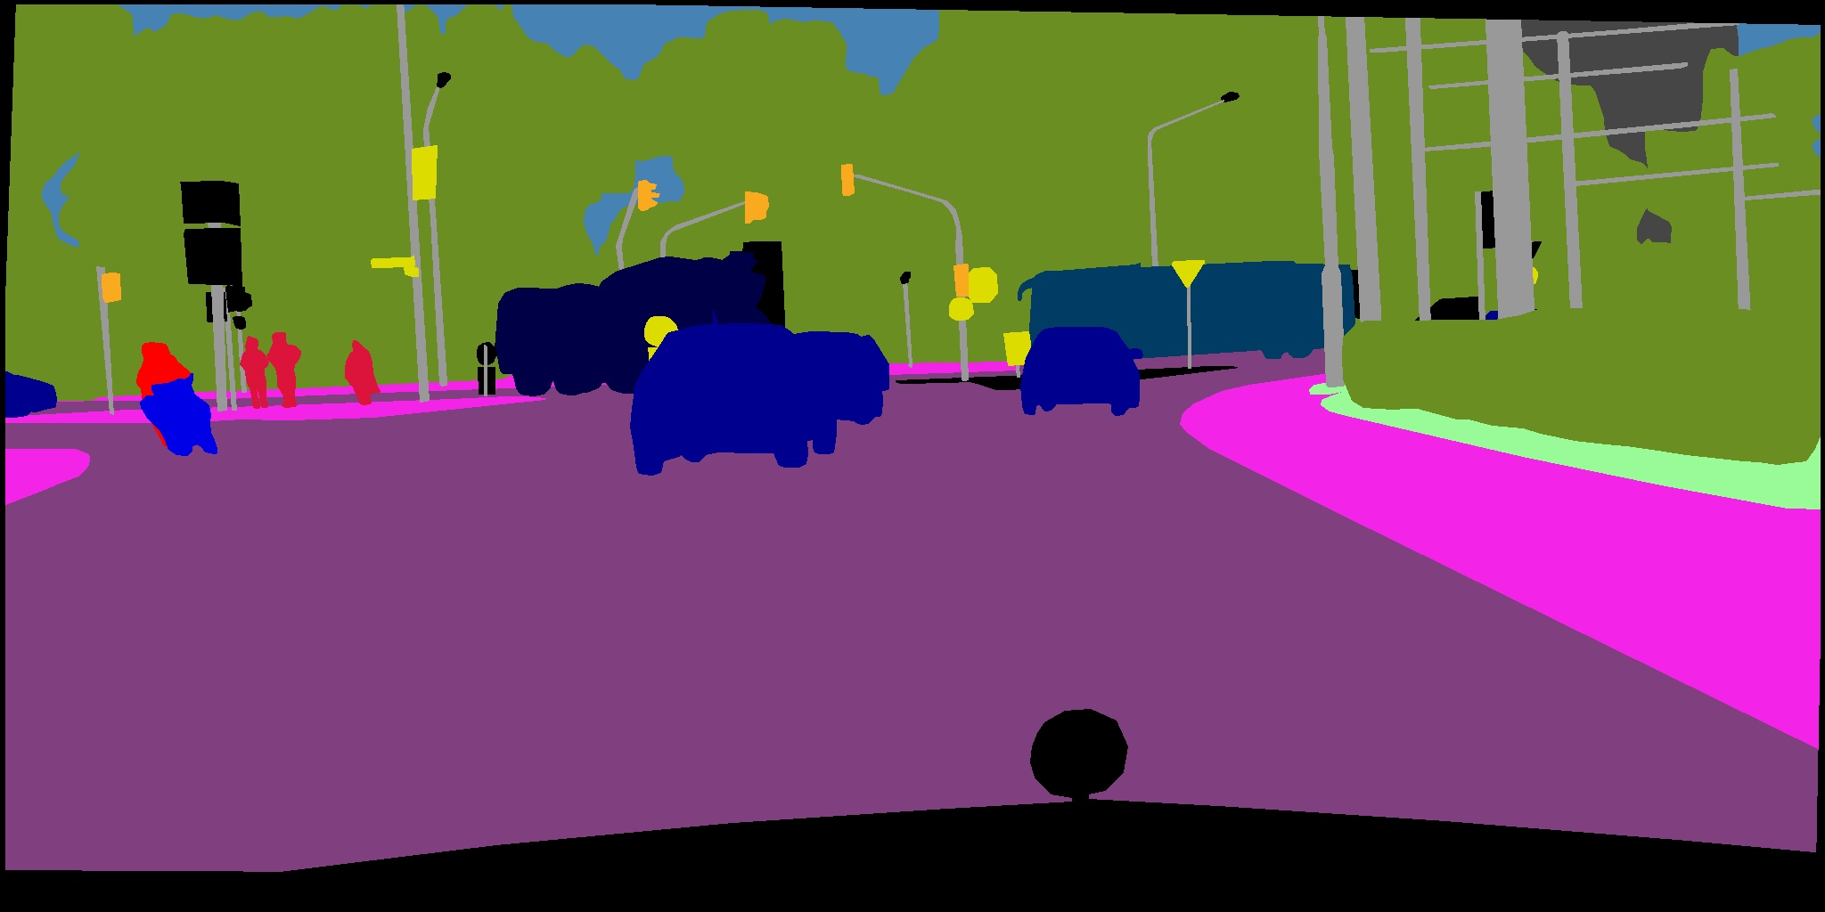
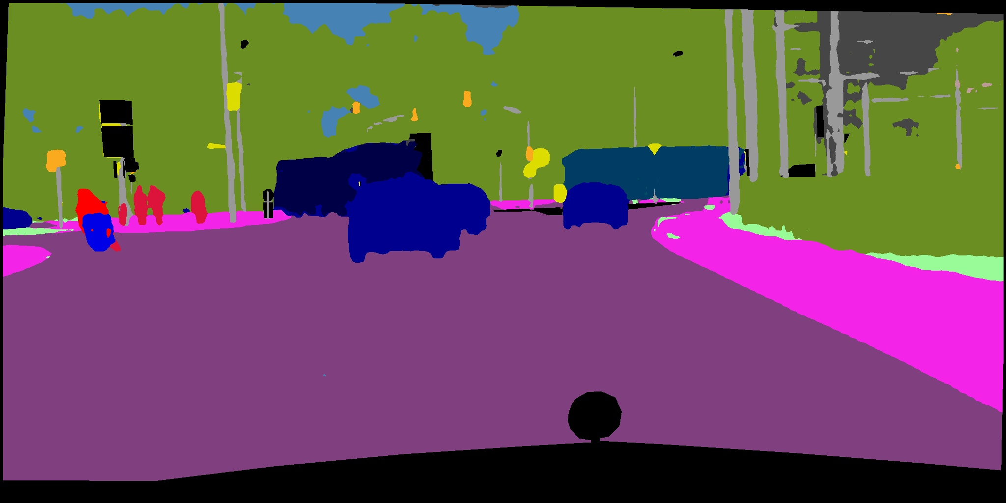
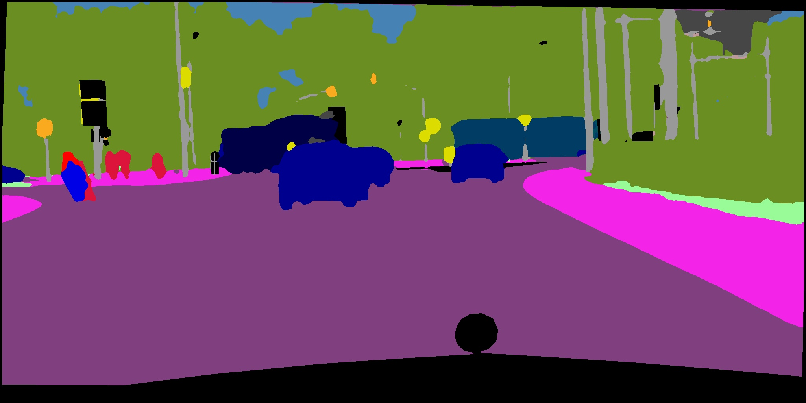
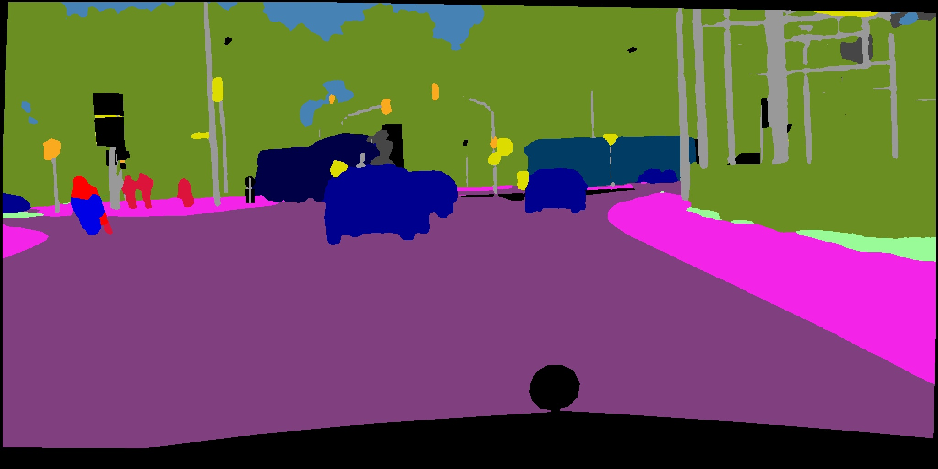

Introduction
Related works
Datasets prepared
Methods
Experiments
Results
road | sidewalk | building | wall | fence | pole | traffic light | traffic sign | vegetation | terrain
sky | person | rider | car | truck | bus | train | motorcycle | bicycle | others
(a) Input
(b) GT
(c) DABNet
(d) ICNet
(e) BiSeNet
(f) Ours
Results of our method and comparison method on Cityscapes dataset I

Slide 33
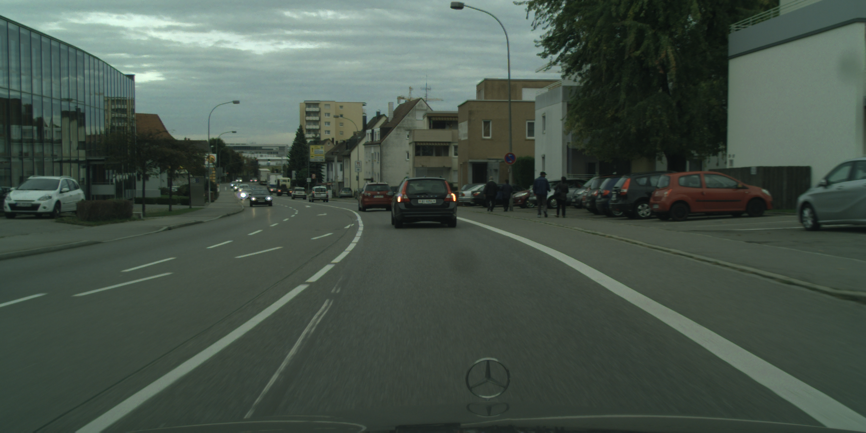
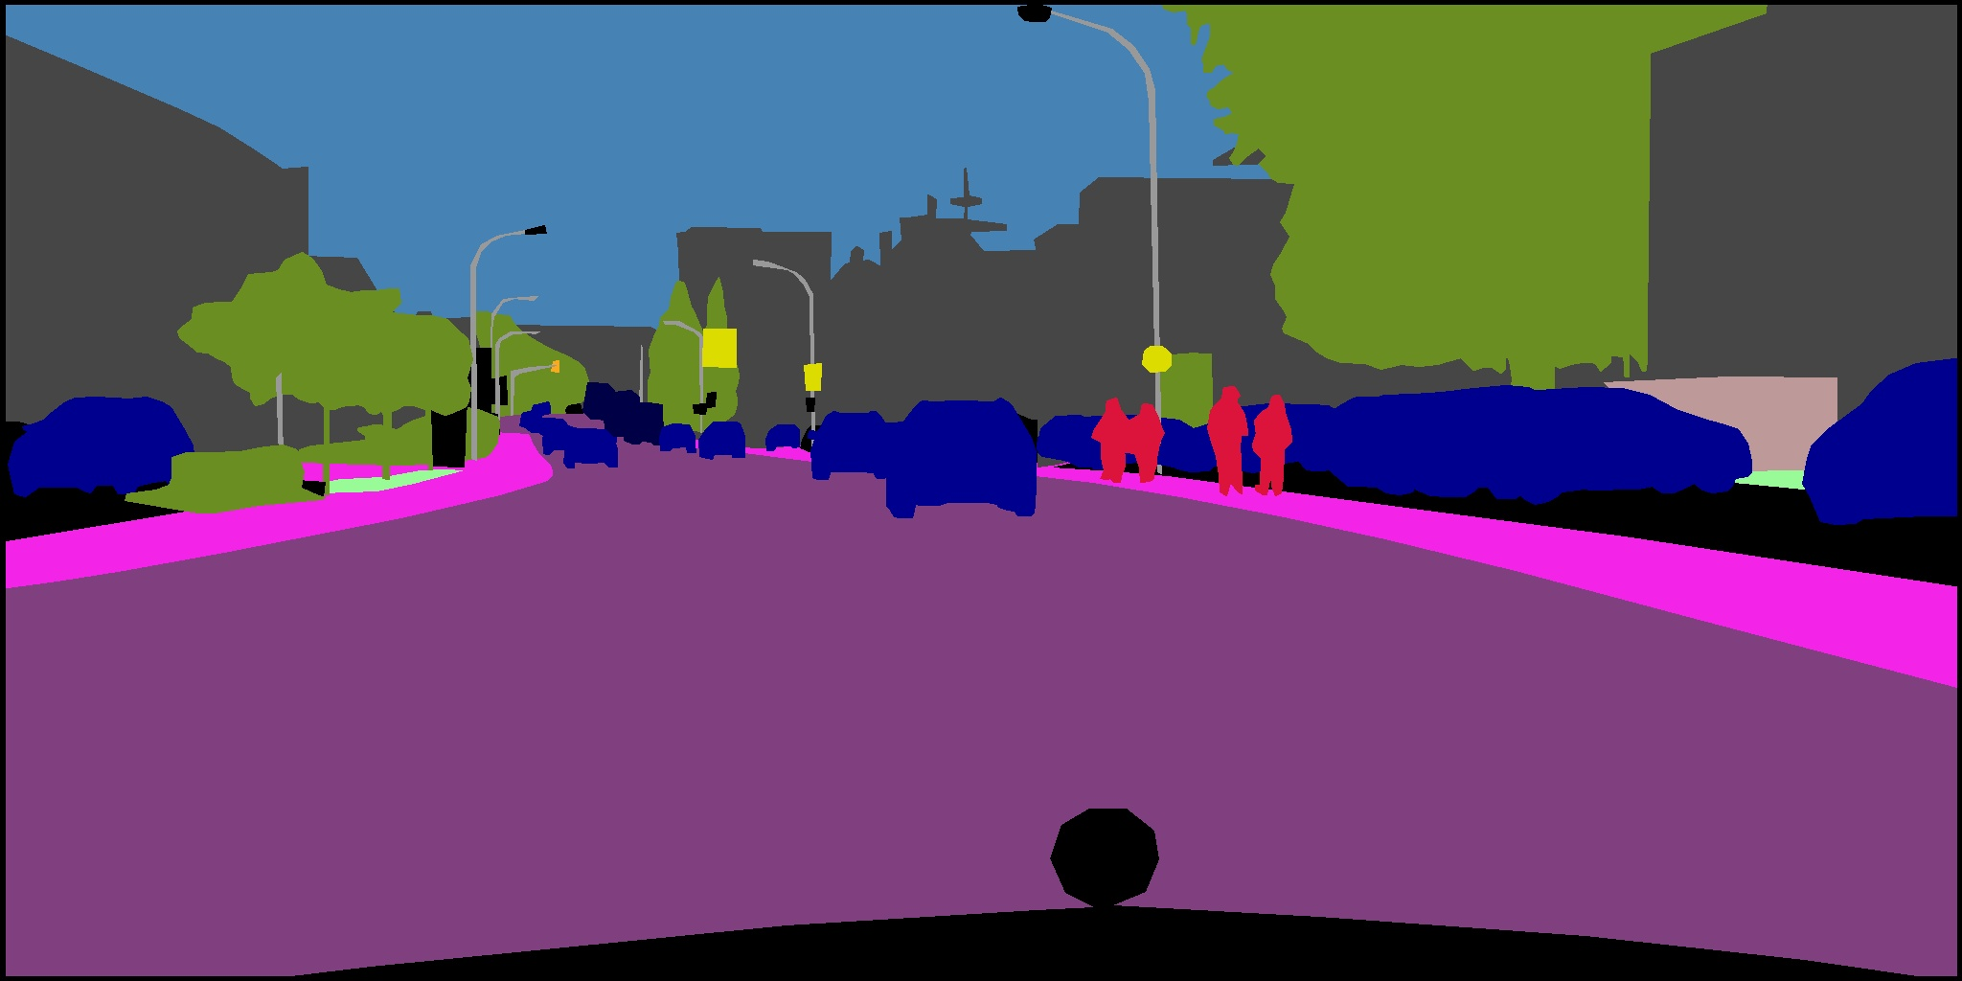
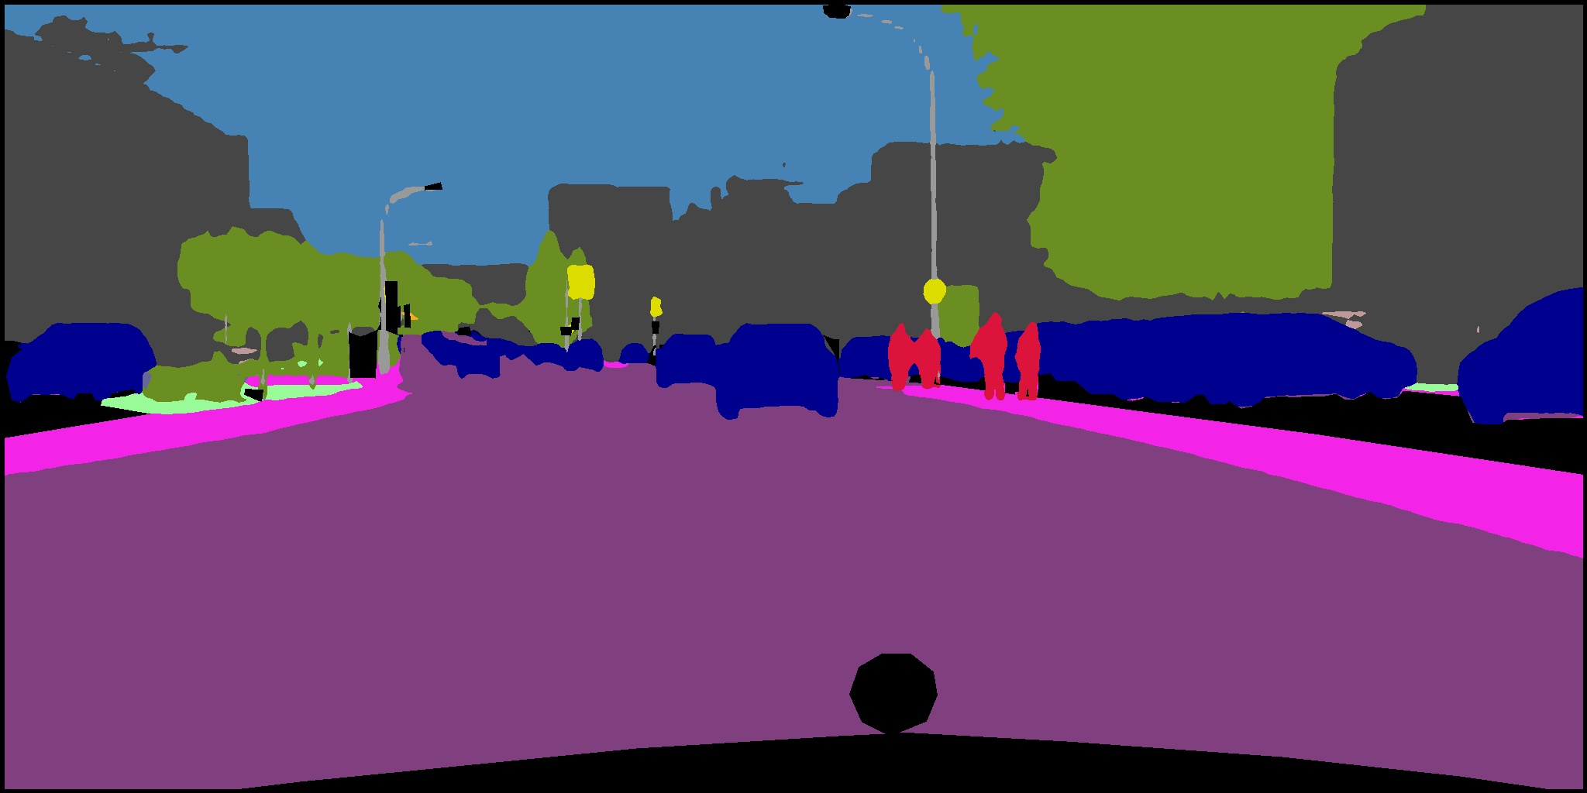
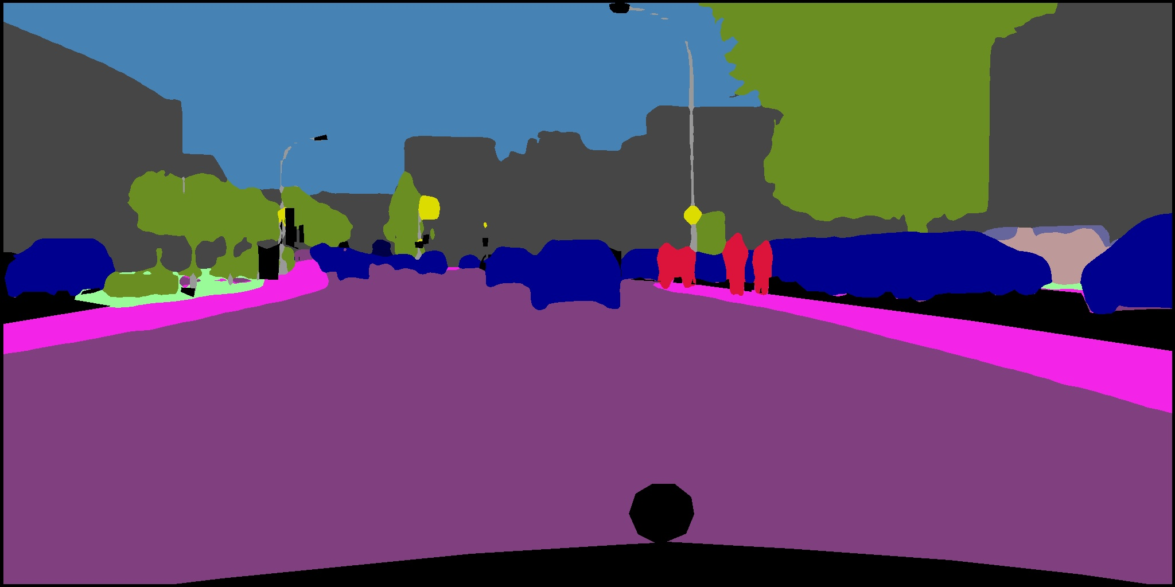
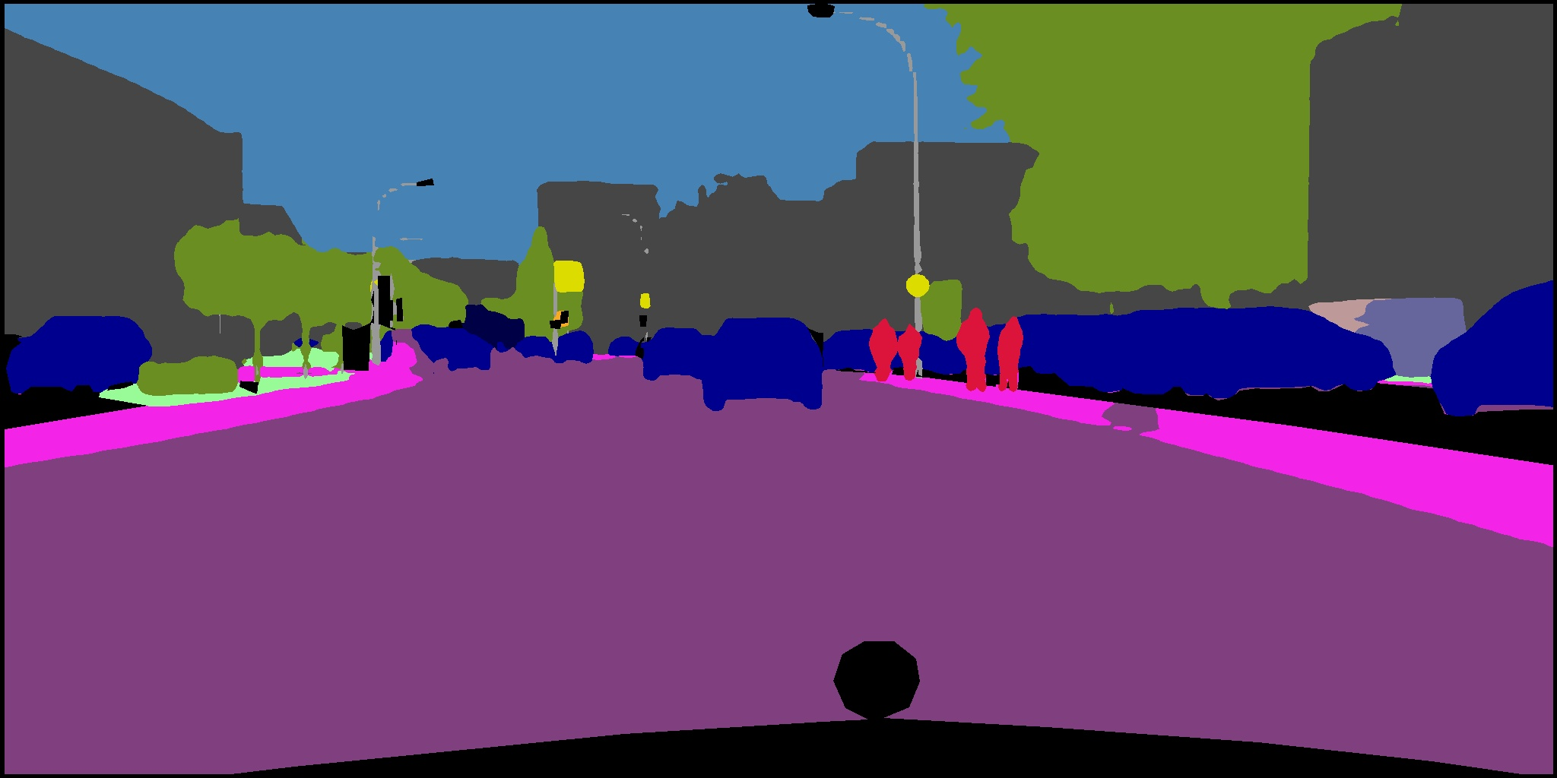

Introduction
Related works
Datasets prepared
Methods
Experiments
Results
road | sidewalk | building | wall | fence | pole | traffic light | traffic sign | vegetation | terrain
sky | person | rider | car | truck | bus | train | motorcycle | bicycle | others
(a) Input
(b) GT
(c) DABNet
(d) ICNet
(e) BiSeNet
(f) Ours
Results of our method and comparison method on Cityscapes dataset II

Slide 34
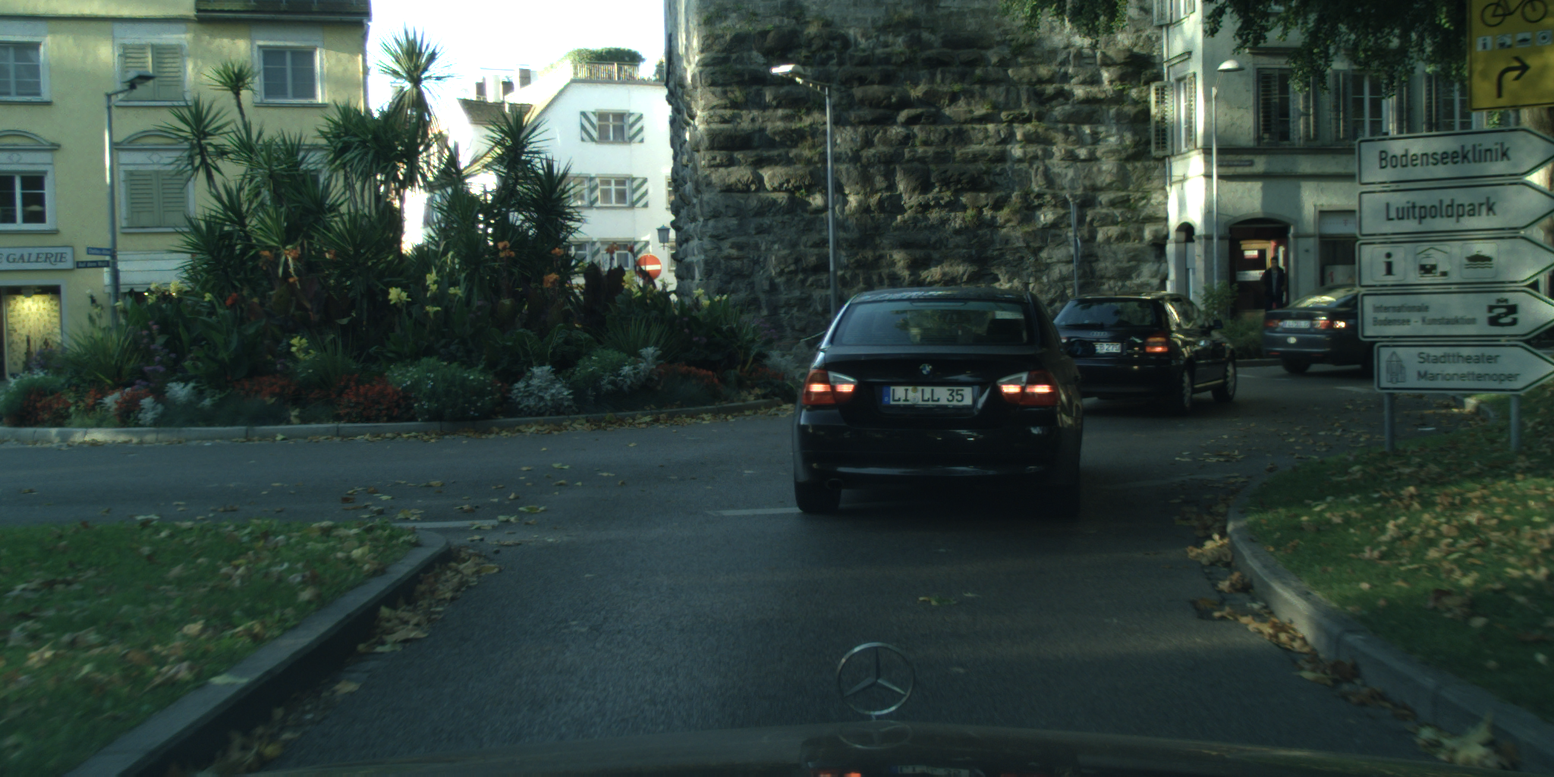
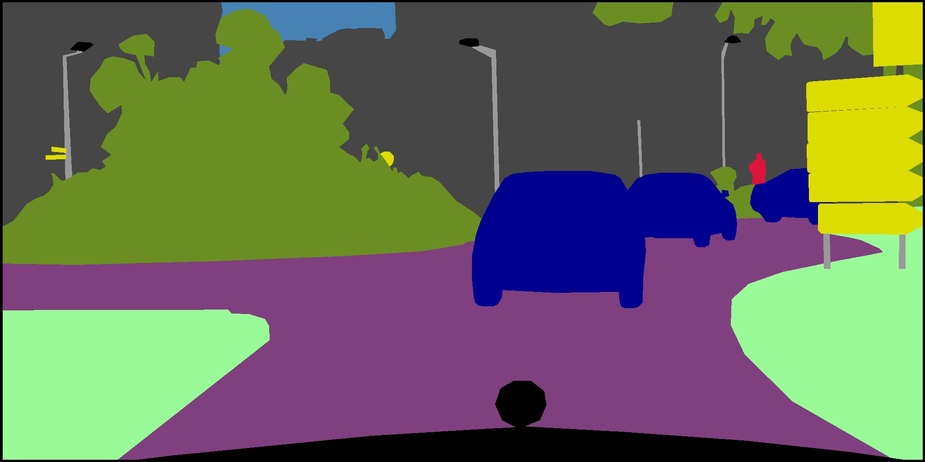
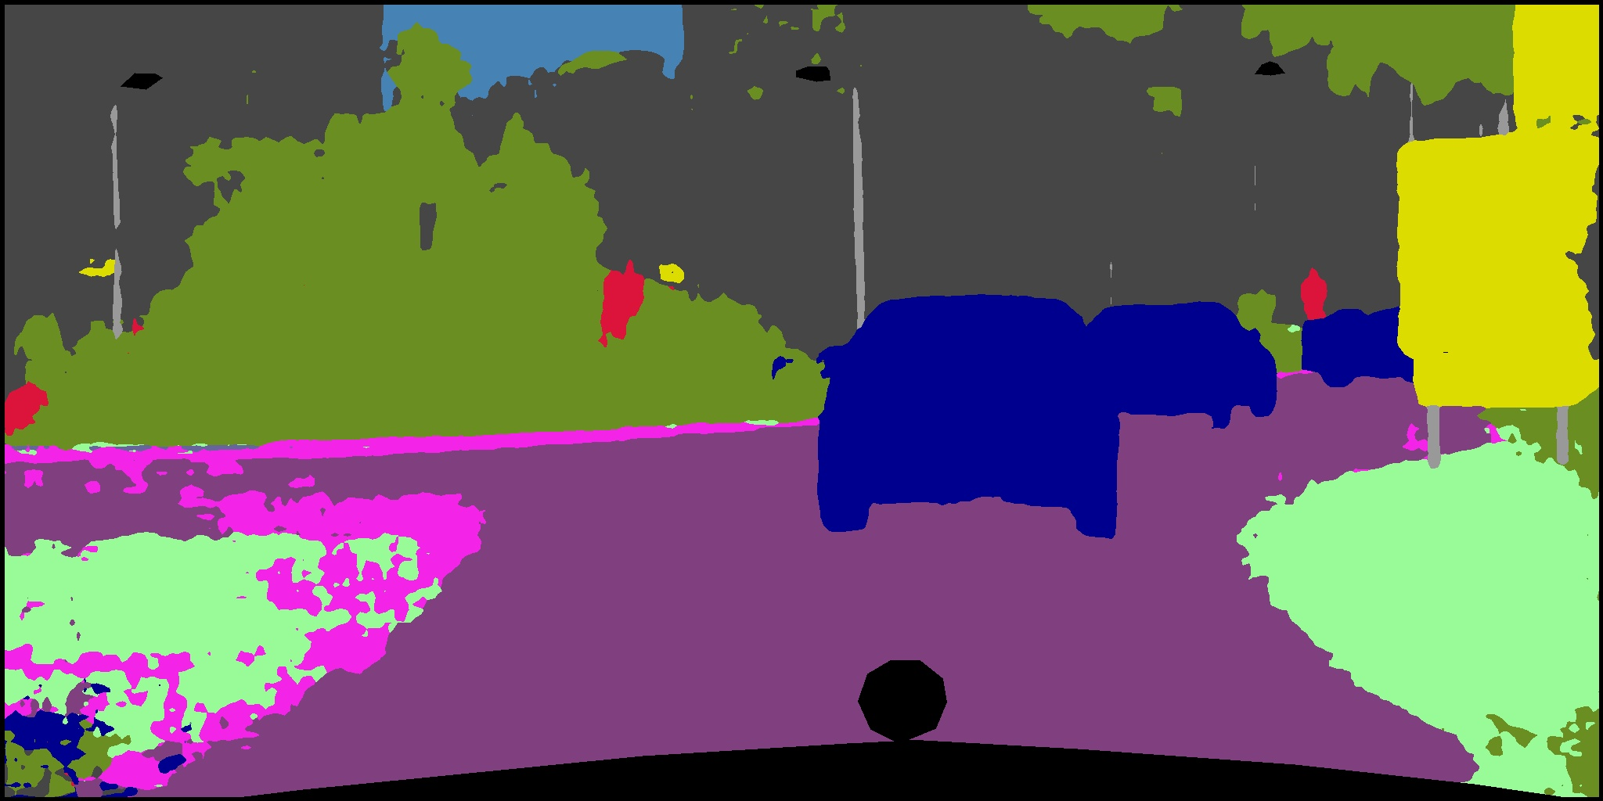
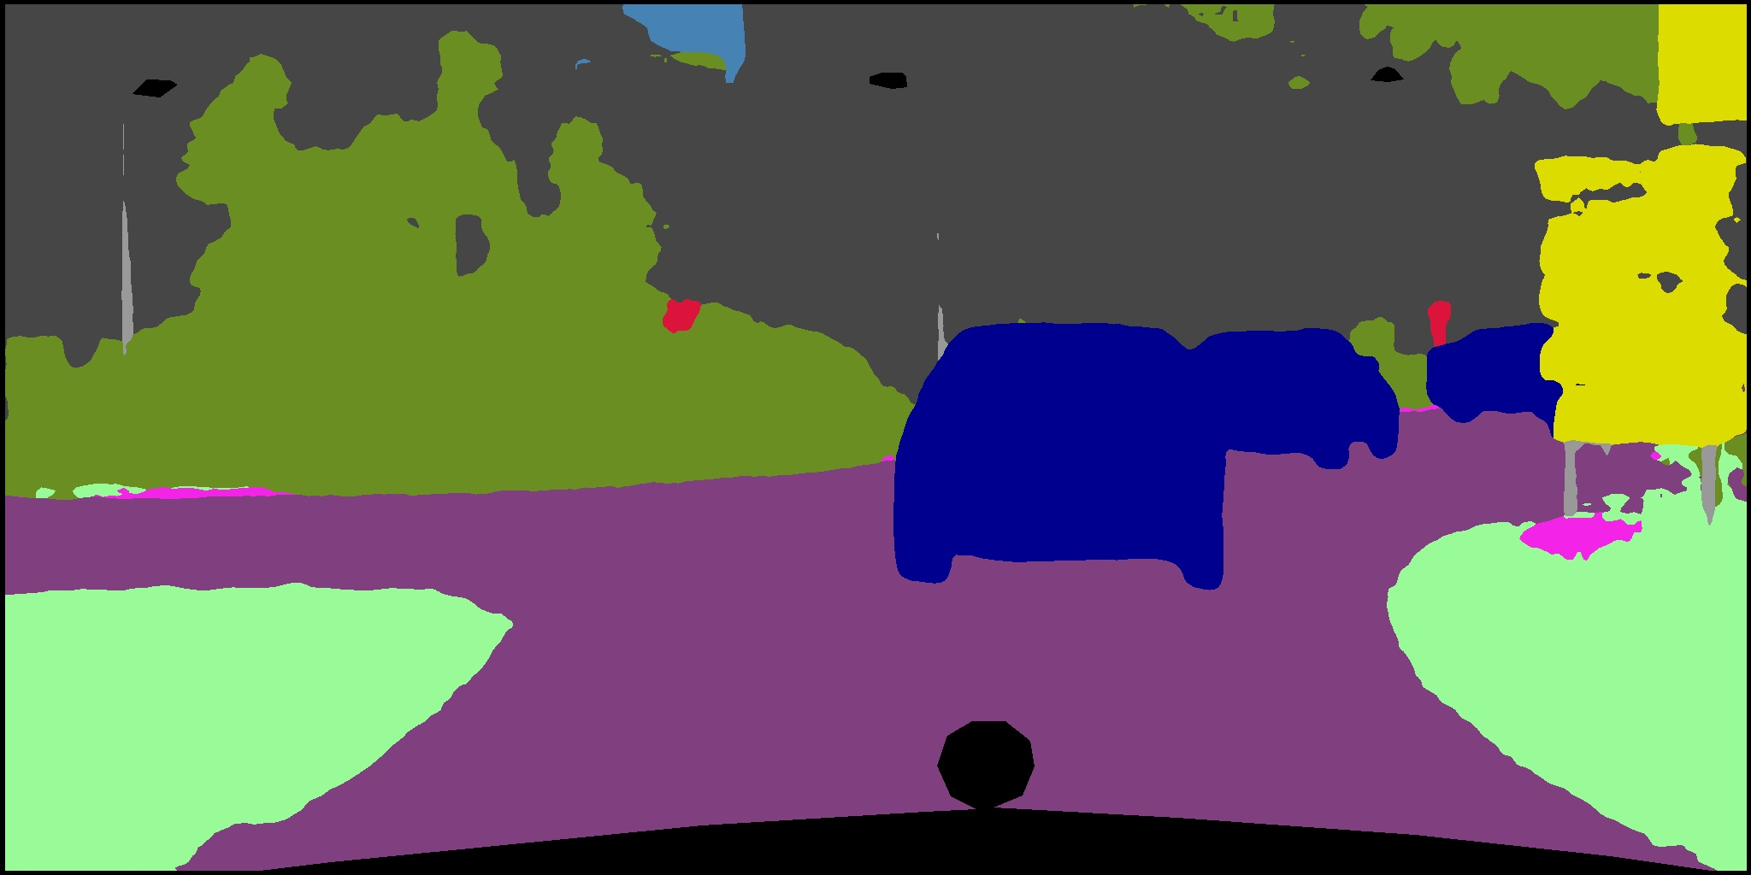


Introduction
Related works
Datasets prepared
Methods
Experiments
Results
road | sidewalk | building | wall | fence | pole | traffic light | traffic sign | vegetation | terrain
sky | person | rider | car | truck | bus | train | motorcycle | bicycle | others
(a) Input
(b) GT
(c) DABNet
(d) ICNet
(e) BiSeNet
(f) Ours
Results of our method and comparison method on Cityscapes dataset III

Slide 35





Introduction
Related works
Datasets prepared
Methods
Experiments
Results
road | sidewalk | building | wall | fence | pole | traffic light | traffic sign | vegetation | terrain
sky | person | rider | car | truck | bus | train | motorcycle | bicycle | others
(a) Input
(b) GT
(c) DABNet
(d) ICNet
(e) BiSeNet
(f) Ours
Results of our method and comparison method on Cityscapes dataset IV

Slide 36
Introduction
Related works
Datasets prepared
Methods
Experiments
Results
Speed and Accuracy Evaluation
Speed and accuracy evaluation on CamVid testing set

Slide 37




Introduction
Related works
Datasets prepared
Methods
Experiments
Results
bicyclist | building | car | column_pole | fence | pedestrian | road | sidewalk | sign_symbol | sky | tree | other
(a) Input
(b) GT
(c) BiSeNet
(d) Ours
Results of our method and comparison method on CamVid dataset I

Slide 38




Introduction
Related works
Datasets prepared
Methods
Experiments
Results
bicyclist | building | car | column_pole | fence | pedestrian | road | sidewalk | sign_symbol | sky | tree | other
(a) Input
(b) GT
(c) BiSeNet
(d) Ours
Results of our method and comparison method on CamVid dataset II

Slide 39

Conclusion
1. We add Refine Residual Block (RRB), which effectively refines features to achieve better accuracy when reducing feature dimensions.
2. We propose Dual Attention Block (DAB), which implements feature aggregation and two different attention modules to obtain accuracy beyond the baseline.
3. According to the experiment, we can find that the channel-wise attention module and the point-wise attention module can achieve complementary effects.
4. We improve the mIoU to 76.8% on Cityscapes validation set, while only reducing the FPS by 10%.

Slide 40
Reference
[1] J. Hu, L. Shen, and G. Sun, “Squeeze-and-excitation networks,” in Proceedings of the IEEE Conference on Computer Vision and Pattern Recognition, 2018.
[2] Z. Zhu, M. Xu, S. Bai, T. Huang, and X. Bai, “Asymmetric non-local neural networks for semantic segmentation,” in Proceedings of the IEEE International Conference on Computer Vision, 2019.
[3] C. Yu, J. Wang, C. Peng, C. Gao, G. Yu, and N. Sang. Bisenet: “Bilateral segmentation network for real-time semantic segmentation.” in Proceedings of the European Conference on Computer Vision, 2018.
[4] K. He, X. Zhang, S. Ren, and J. Sun, “Deep residual learning for image recognition,” in Proceedings of the IEEE Conference on Computer Vision and Pattern Recognition, 2016.
[5] F. Chollet, “Xception: Deep learning with depthwise separable convolutions,” in Proceedings of the IEEE Conference on Computer Vision and Pattern Recognition, 2017.
[6] A. G. Howard et al., “MobileNets: Efficient convolutional neural networks for mobile vision applications,” arXiv preprint arXiv:1704.04861v1 [cs.CV], 2017.
[7] K. He, X. Zhang, S. Ren, and J. Sun, “Spatial pyramid pooling in deep convolutional networks for visual recognition,” in Proceedings of the European Conference on Computer Vision, 2014, pp. 346–361.

Slide 41


